Slide 1
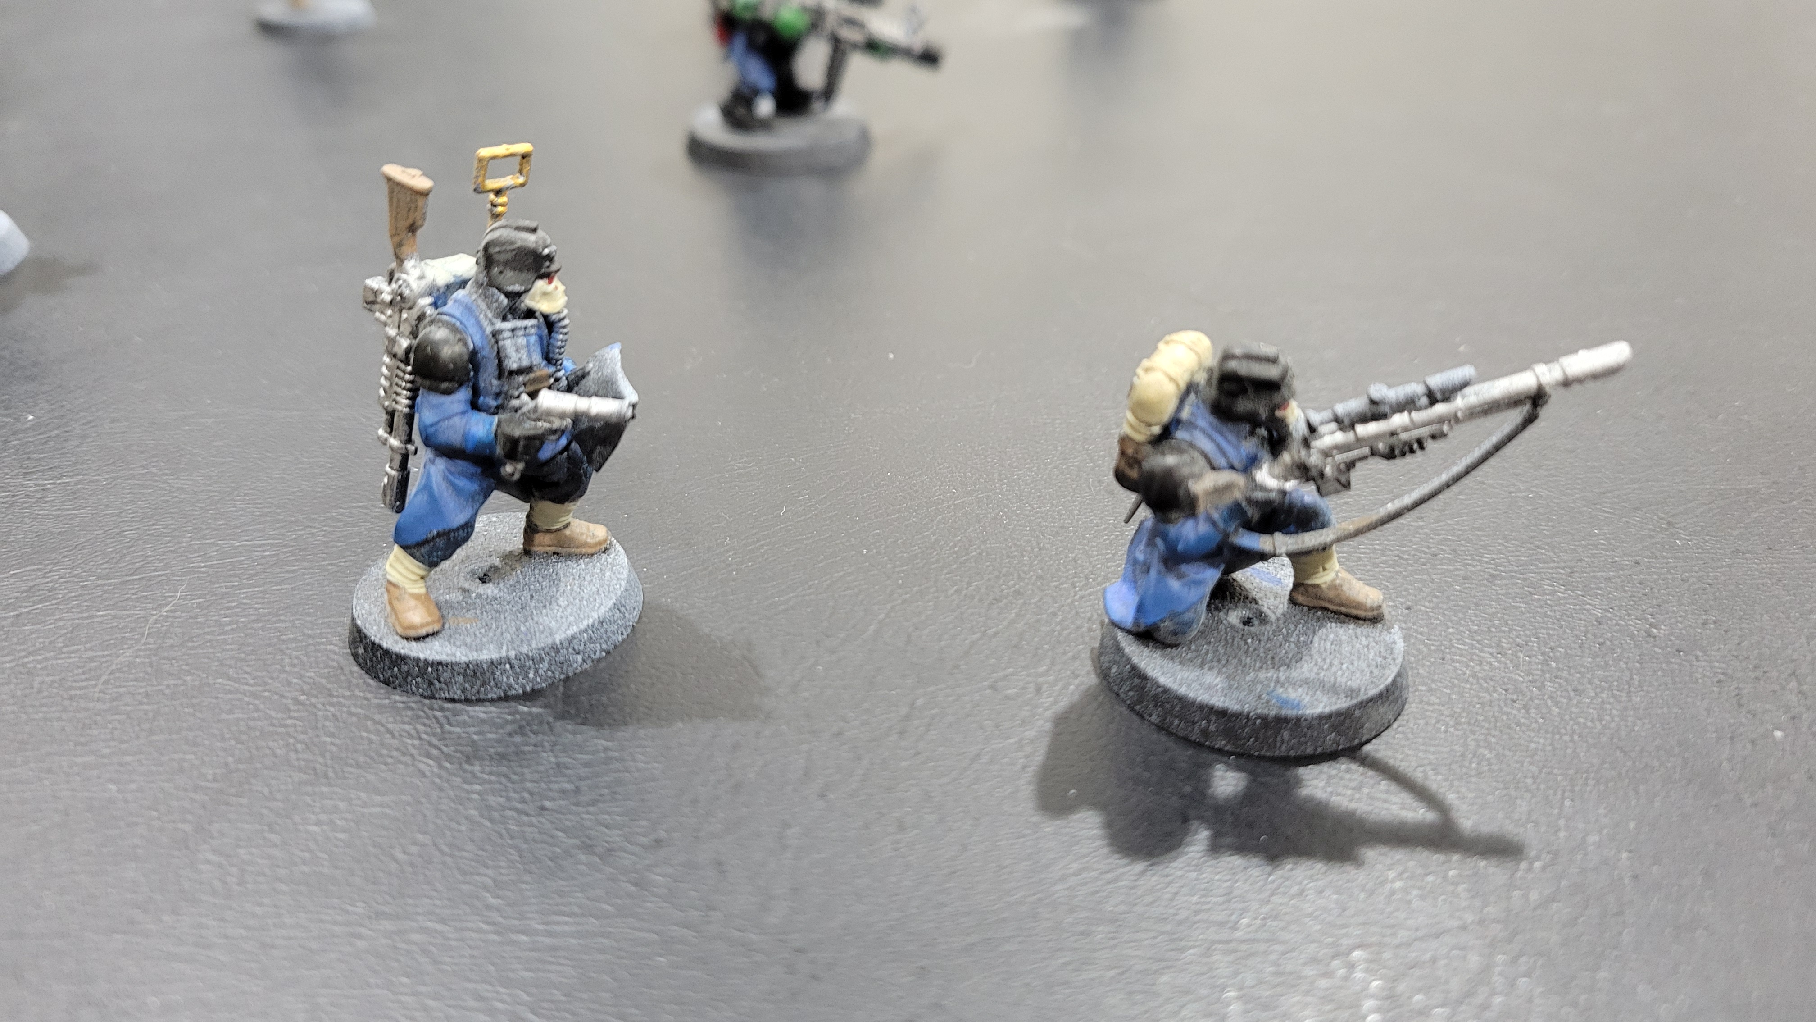
Miniature Object Detection
DATA 690 AI
Brett Duvall

Slide 2
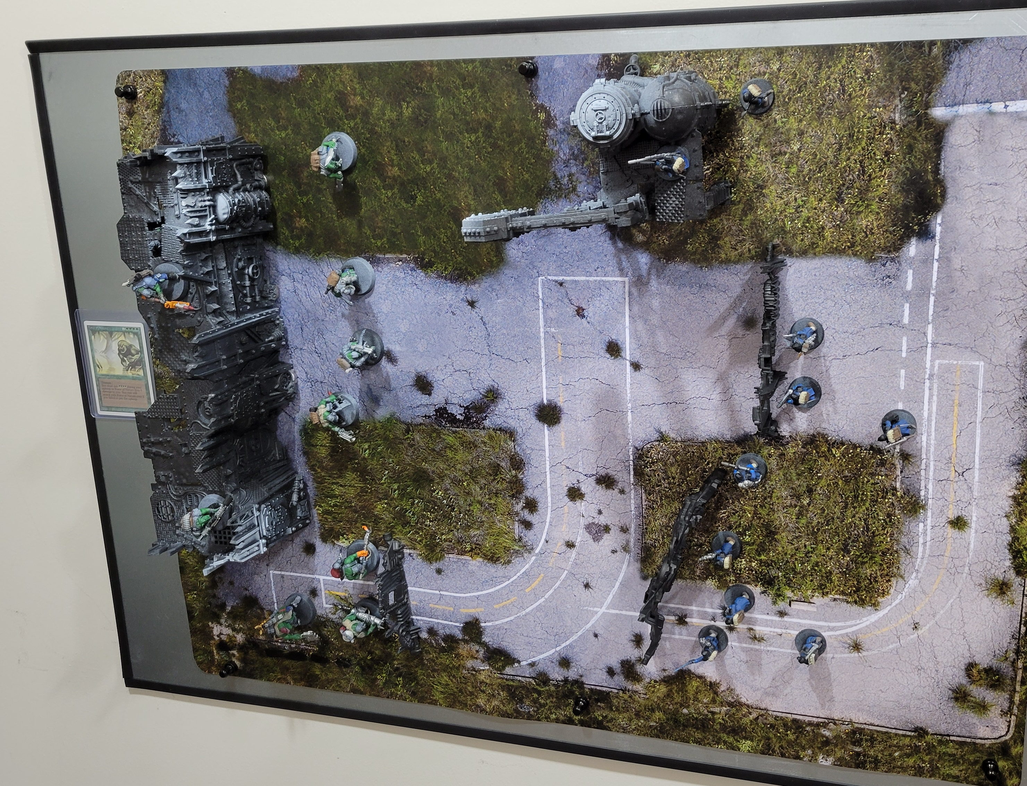
Intro
Warhammer is a very popular miniature combat game
Team Kill is the smaller version with 9-10 unique miniatures per team
My brother, nephew, and I used to play boardgame in the game room (until my nephew outgrew gaming)
Let’s train AI to play when no one else is around

Slide 3
Project Aim
Start with training to detect each miniature on the gameboard
Each miniature is a unique class with unique stats
Have each class name and stats (such as hit points) shown on their corresponding bounding box
Control movement, attack, and defend choices using hand gestures
Compute any battles and subtract hit points from defender
Train AI to play either team and make decisions based on state-action policy reinforcement learning algorithm

Slide 4
Approach
18 miniatures
Collect video
Create image for each frame
Annotate each frame
Train on image/label data
Check training statistics
Check inference
Add additional set of images with a different background to force training to see only the miniature

Slide 5
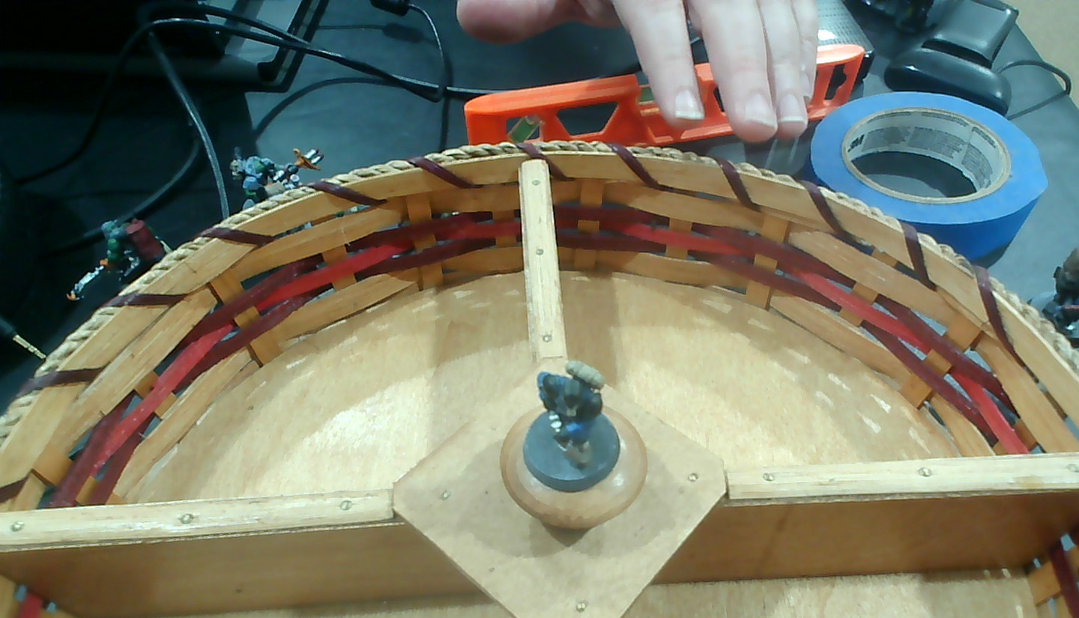
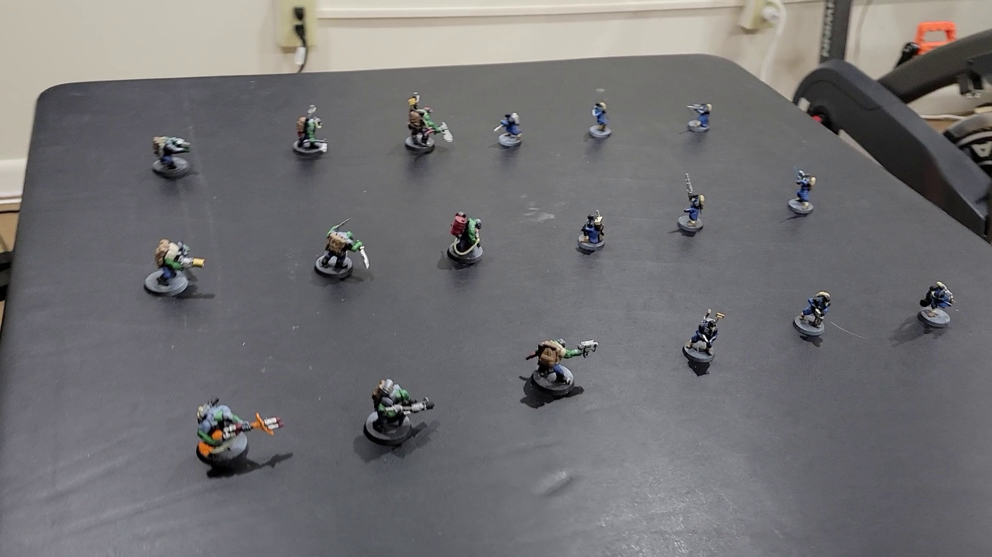
Data
Two sets of images taken from webcam videos
First set:
16,000 images taken at 3 different angles from a 720p webcam
Each of the 18 miniatures was shot on a rotating lazy susan to minimize blurring of each image
Second set:
780 images taken from 3 different angles from a 1080p camera (cut down from 7,000)
All 18 miniatures were together in frame

Slide 6

Project Workflow
Videos were split into images using extract_frames function from our labs
LabelImg was used for annotation
Yolosplitter was used for separating the annotated files & txt labels into train (70%), test (20%), and validation (10%)
Yolo11n was used for training (with augmentations adjusted)
MLFlow was used for tracking during training (100 epochs)
Yolo was used for inference

Slide 7
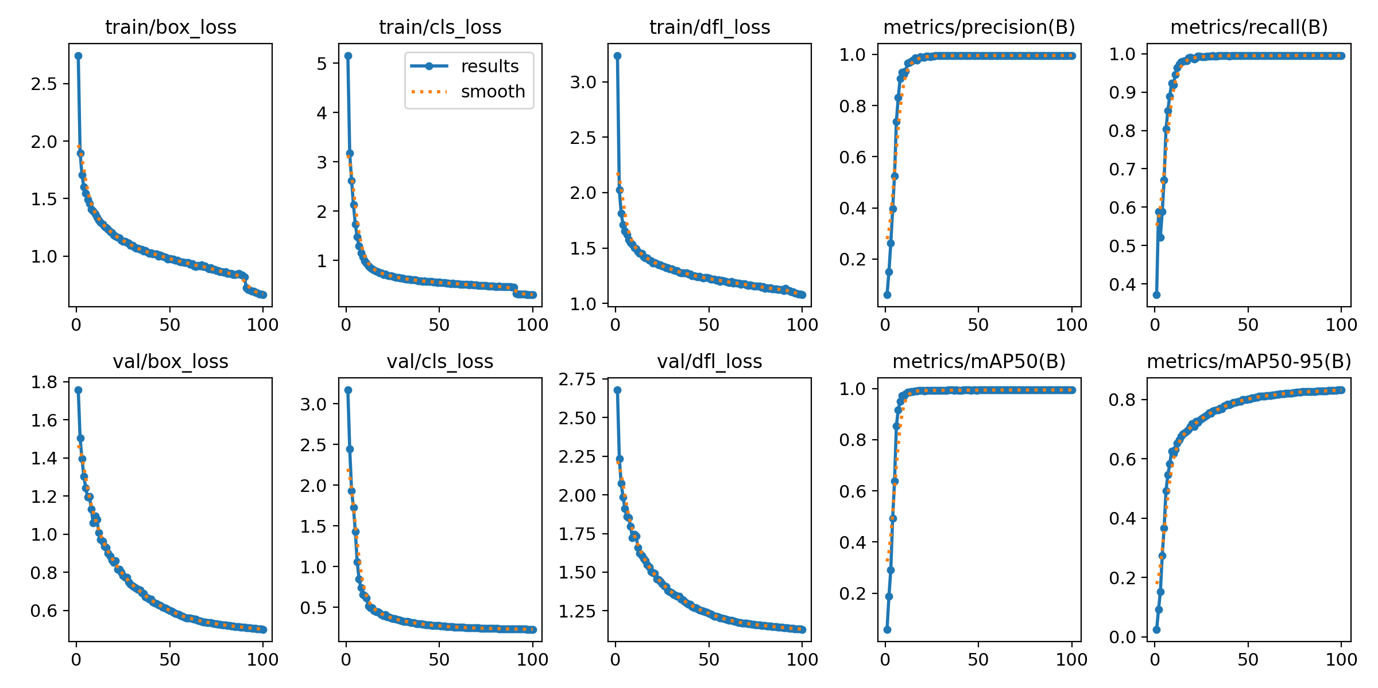
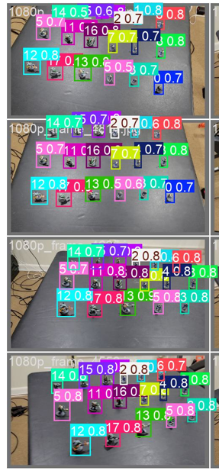
Evaluation

Slide 8
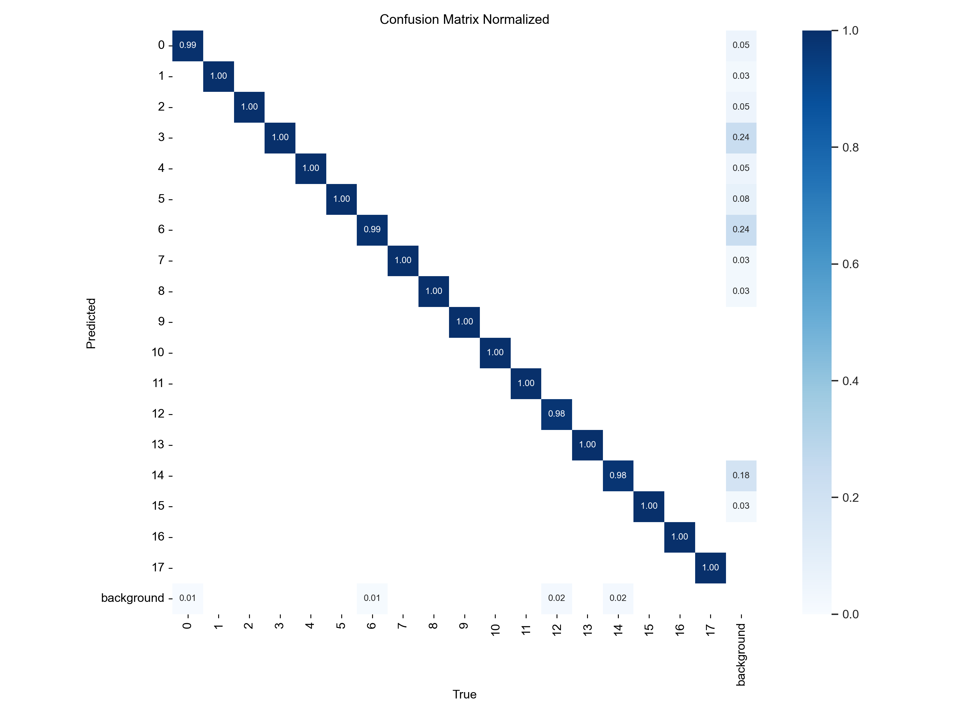
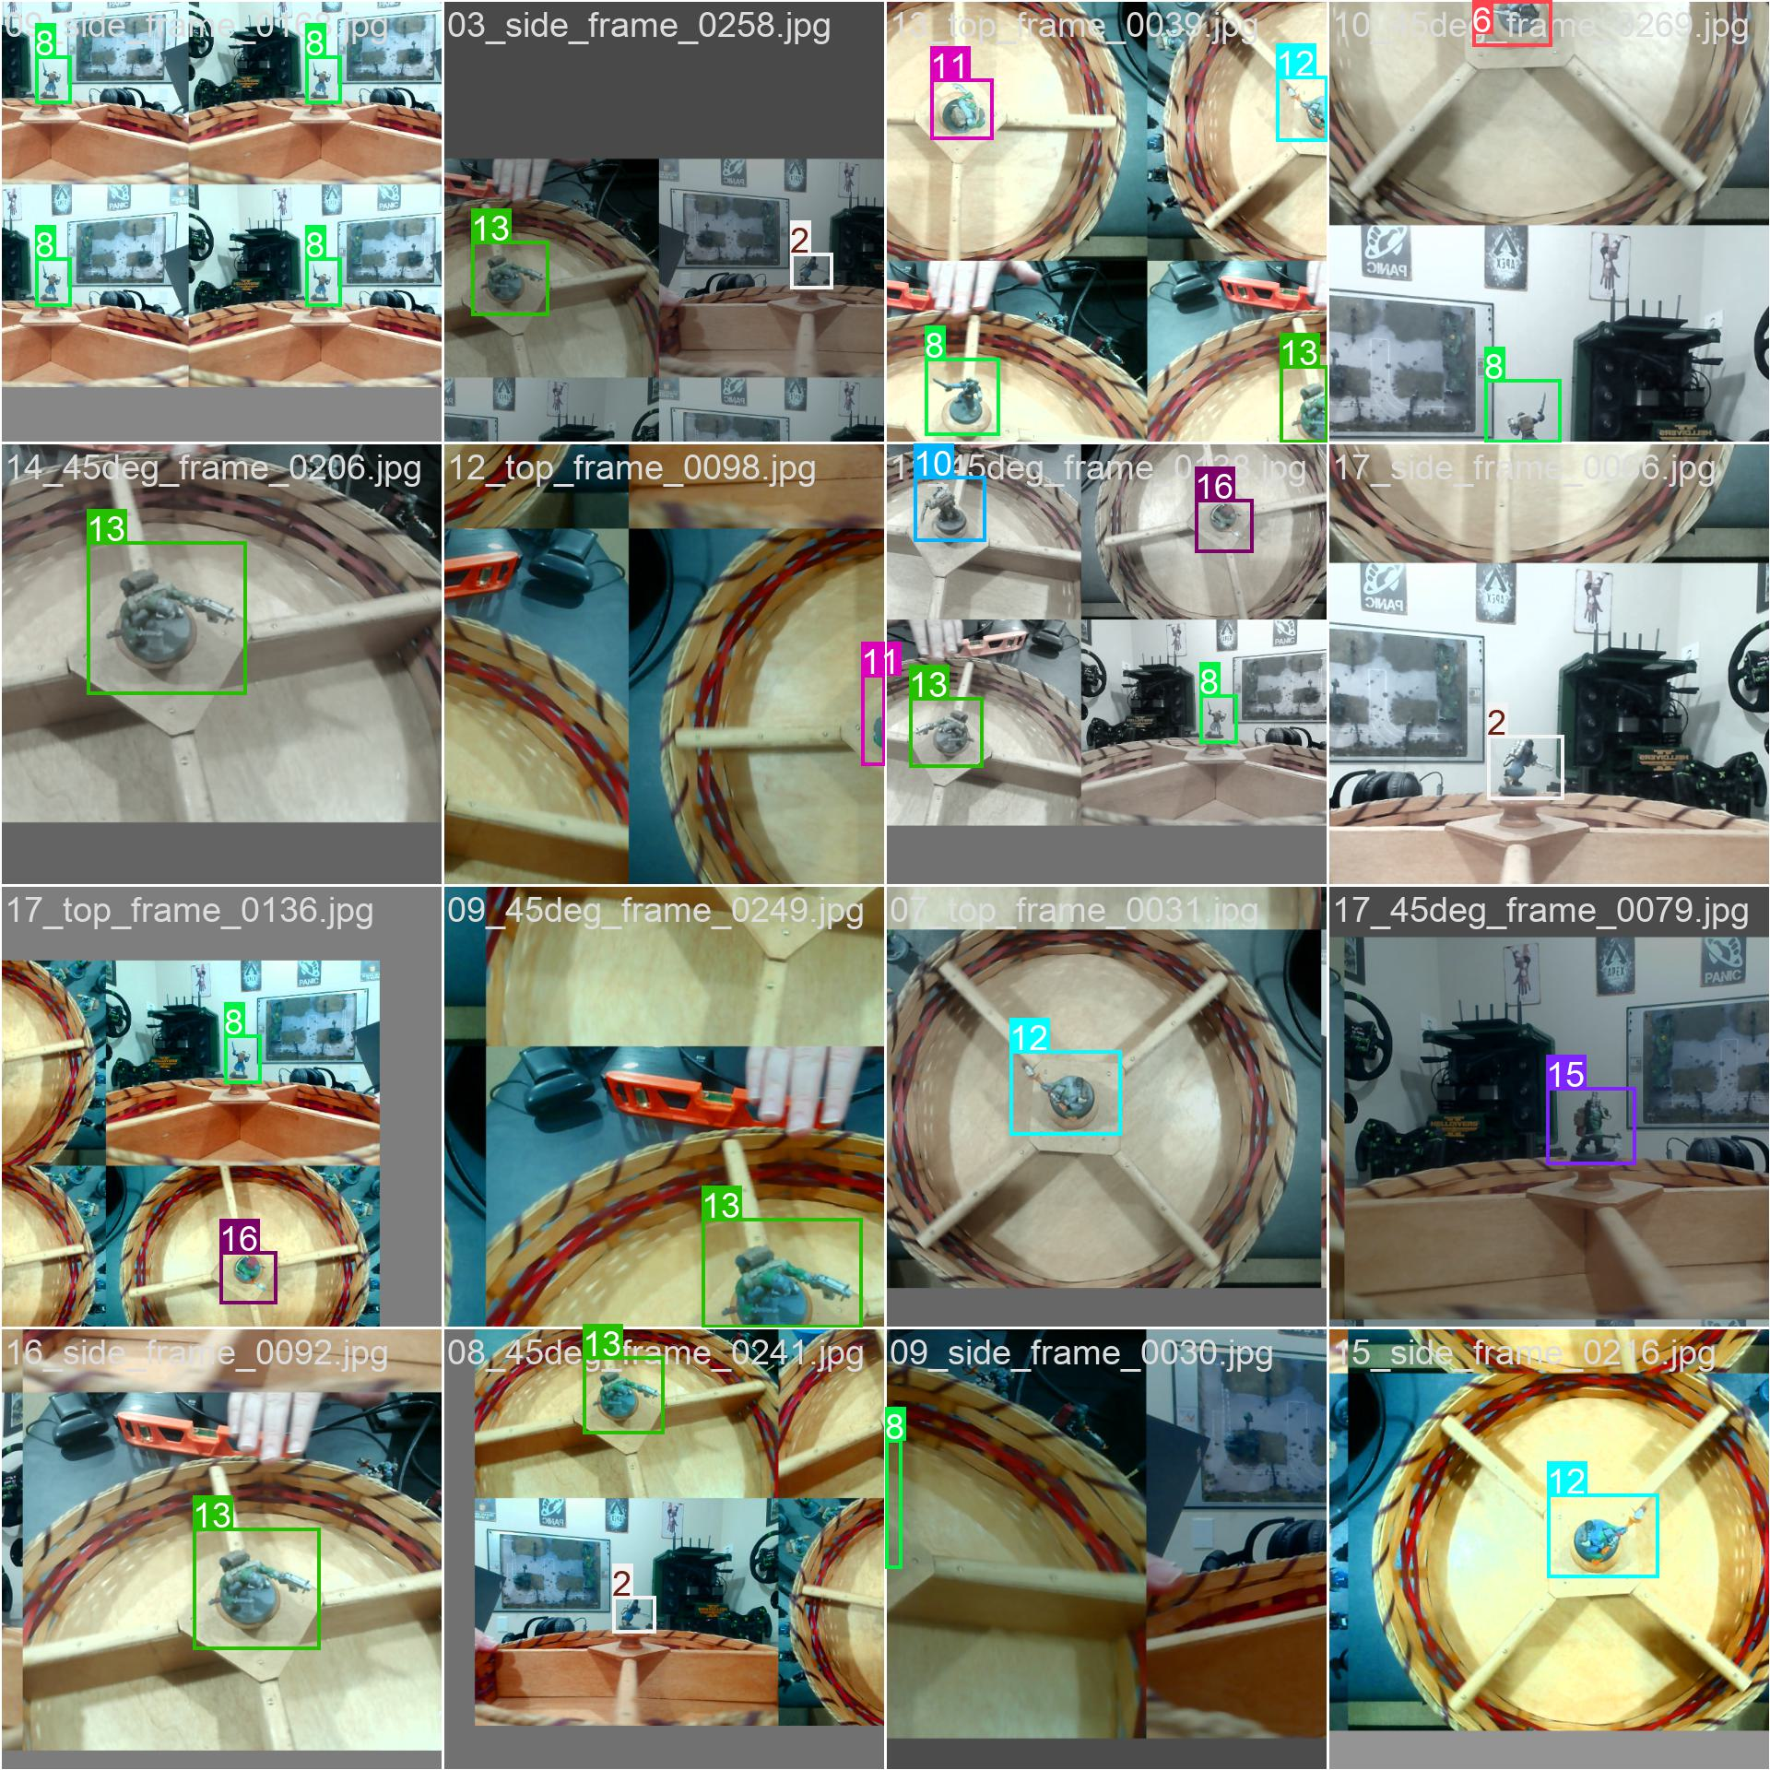
Confusion Matrix Normalized

Slide 9
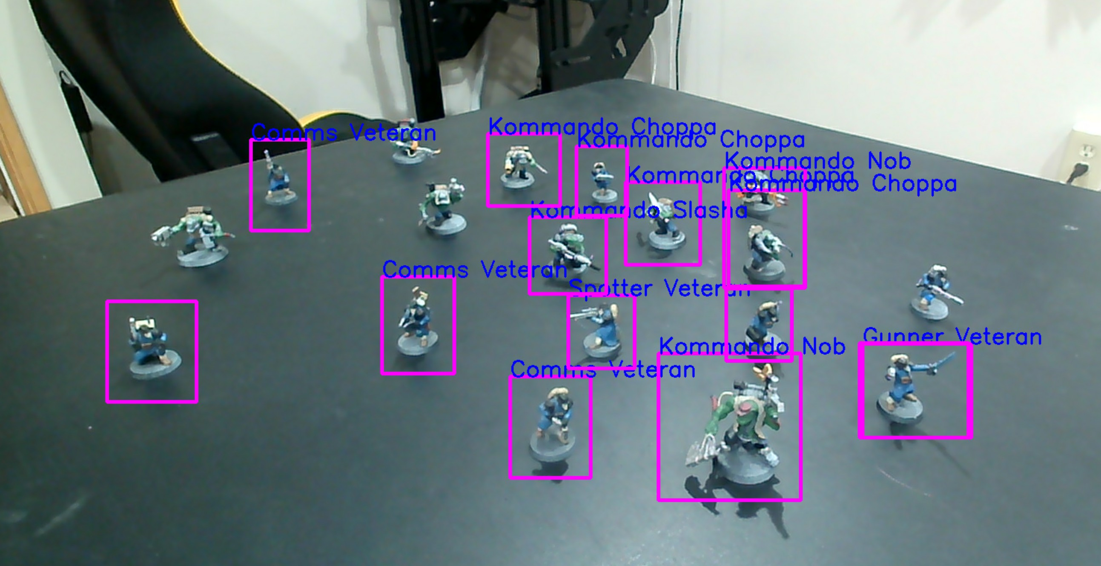
Inference

Slide 10
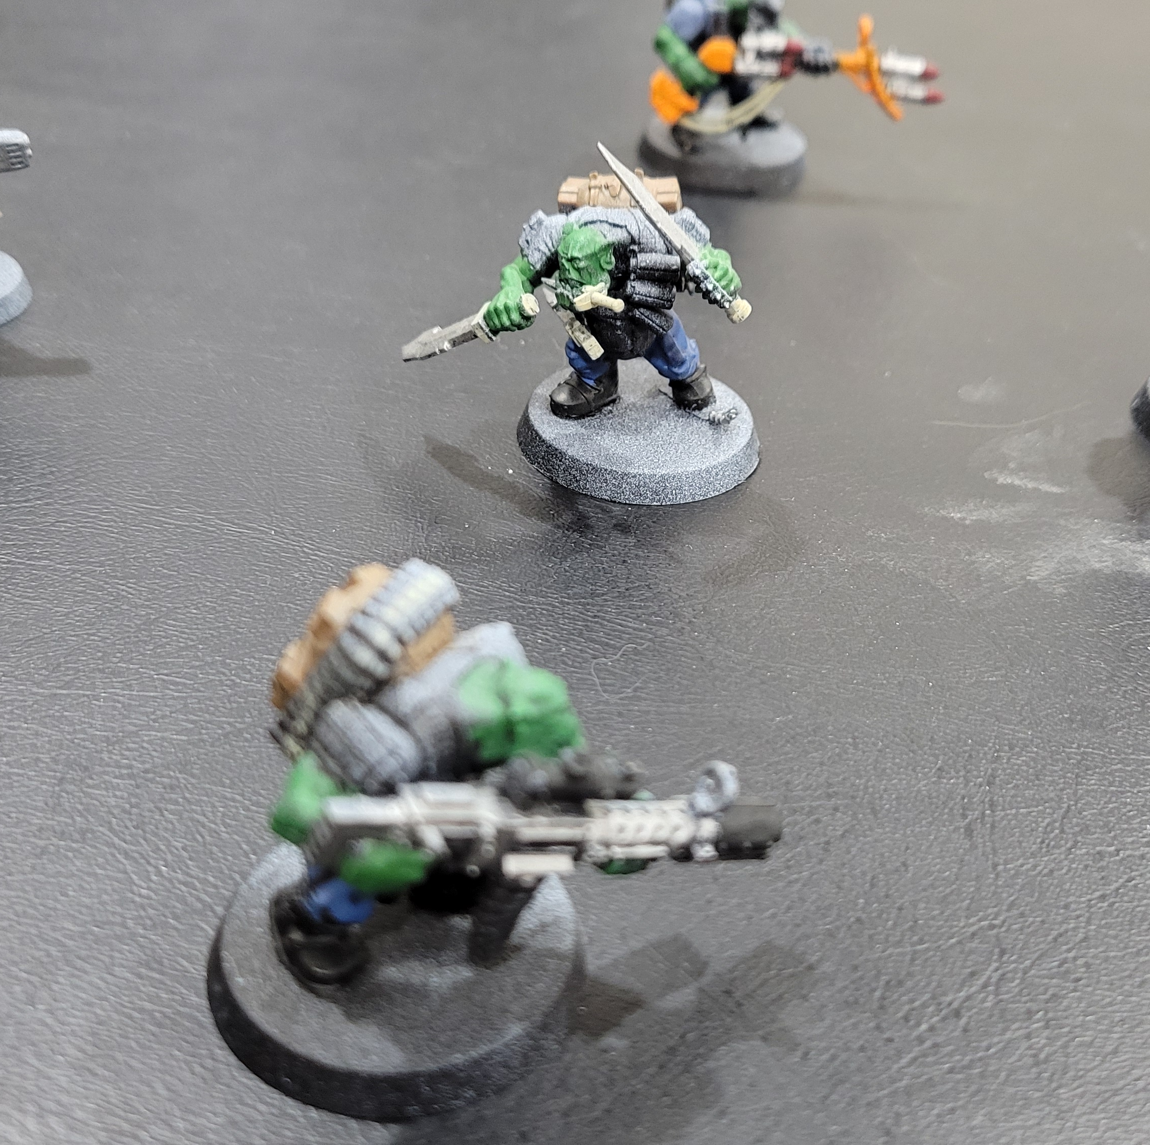
Future Work
Check different angles
Check which minis are hard to detect
Confidence levels?
Higher resolution?
Add hand gesture and attention for ui
Add stats for each mini
Add combat calculations
Add AI strategy training

Slide 11
References
Ultralytics - https://docs.ultralytics.com/guides/
Real-time Object Detection with YOLO and Webcam: Enhancing Your Computer Vision Skills. Dipankar Medhi. Mar 27, 2023. Medium. https://dipankarmedh1.medium.com/real-time-object-detection-with-yolo-and-webcam-enhancing-your-computer-vision-skills-861b97c78993
THANK YOU!

